Slide 1
Microsoft PowerApps in Retail
Powerful tools to enable business and IT champions to accelerate digital transformation
© Microsoft Corporation PowerApps
Notes:
[Speaker Introduction]

Slide 2
Digital transformation aspirations
Know your customers
80% of a company’s revenue comes from just 20% of its existing customers¹
Empower your employees
Only 36% of Firstline Workers have the technology tools they need²
Intelligent Supply Chain
Nearly 70% of retailers are ready to make changes to adopt IoT³
Retail Reimagined
Leaders across all retail segments have spent 69% more as a percentage of revenue on IT than laggards⁴
Deliver personalized and relevant customer experiences to increase loyalty, market share, and revenue
Create a modern workplace that optimizes work force investment to drive ROI and customer experience
Improve efficiency, agility, and cost management to
offer the best customer experience
Reimagine your business model by starting with the customers and working backwards
¹Gatner
²Forbes Insights, “Empowering the Firstline Workforce: Technology, Autonomy and Information Sharing Deliver Growth to Forward-Thinking Organizations”, 2017
³Supply Chain 24/7, “Seven in Ten Retailers to Invest in IoT Technologies.” March 6, 2017
⁴Lee, Gary. “Why 90 percent of sales still happen in brick and mortar stores.” Retail Technology Review, 2017
© Microsoft Corporation PowerApps
Notes:
Digital transformation means different things to different industries. For today’s retailer, it requires a complete transformation of how customers can experience their products.
Today, the customer journey begins with knowing your customers. On average, as few as 35 percent of your customers account for up to 80 percent of a typical retailer’s profits. It therefore makes sense that you need to be able to identify your best customers, create custom offers and rewards that uniquely appeal to them, and tailor their shopping experience to provide a more personalized and enjoyable journey to build customer loyalty, increase market share, and maximize revenue opportunities. Retail customers today leverage vast amounts of real-time information to make purchasing decisions such as cost comparisons, reviews and recommendations, competitor information, and stock availability. Similarly, retailers have access to information about their customers through advanced analytics that provide extensive demographic information, trend analysis, and a wealth of personal information that consumers themselves will freely provide to help ensure they get exactly what they want, when they want it, from their preferred retailers.
Another important component of the customer journey is empowering your employees. Customers are understandably frustrated when working with a retail employee, either in person or over the phone, who doesn’t know your products, doesn’t understand the customer’s needs, and doesn’t add any value to the shopping experience such as recommending similar or alternative products and solutions, answering basic questions, or checking stock availability in other store locations. These firstline workers are likewise frustrated by their lack of empowerment and the resulting customer frustration that is often directed at them. In a recent Forbes Insight article, only 36% of firstline workers felt they had the technology tools they needed to be more productive and helpful in delivering a superior customer experience.
Next, retailers are looking for ways to optimize their supply chain to create an intelligent supply chain. Zebra Technologies reports that 70 percent of retailers globally are ready to adopt IoT technologies and 79% of North American retailers are already investing in IoT technologies such as RFID, automated inventory verification, and various sensors in stores and warehouses to optimize their supply chains. Increasing adoption of IoT in consumer products will further enable retailers to deliver the best customer experience by analyzing data such as usage patterns to anticipate pending servicing needs, offer automatic replenishment of consumables, and deliver other personalized, value-added services.
Finally, retailers are reimagining the retail experience. This means focusing on the customer and adopting new technologies that enable your customers to engage with your brand at every touch point, across any channel and empowering your employees to deliver a superior customer experience every time.
----------------------------------------
¹Need reference from Cath Brands
²Forbes Insights, “Empowering the Firstline Workforce: Technology, Autonomy and Information Sharing Deliver Growth to Forward-Thinking Organizations”, 2017, http://info.forbes.com/rs/790-SNV-353/images/Microsoft_Empowering%20Workforce.pdf
³Supply Chain 24/7, “Seven in Ten Retailers to Invest in IoT Technologies.” March 6, 2017: https://www.supplychain247.com/article/seven_in_ten_retailers_to_invest_in_iot_technologies
⁴Lee, Gary. “Why 90 percent of sales still happen in brick and mortar stores.” Retail Technology Review, 2017: https://www.retailtechnologyreview.com/articles/2017/10/17/why-90-percent-of-sales-still-happen-in-brick-and-mortar-stores

Slide 3
Digital gaps in today’s functional model
Commerce
Operations
Customers
Worker
Productivity
Payment, POS
ERP
CRM
Paper
Excel
Ad hoc DB
Functional business silos create digital process gaps
Changing business processes also create digital gaps within functions
© Microsoft Corporation PowerApps
Note: This model is presented for discussion purposes only, is not meant to be a formal or comprehensive industry IT architecture
Notes:
However, digital gaps exist in today’s functional IT model that create barriers to fully achieving digital transformation in retail. You’ve made significant investments over the years in systems like ERP, POS, and CRM, but these backend systems are quite often siloed, inflexible, and well, backend! In many cases, these systems are inflexible and cannot be easily customized to meet changing business needs. They are also difficult to integrate, maintain, and upgrade. These systems do little to help your firstline retail employees that are interacting with your customers on a daily basis deliver a superior customer experience. Instead, they often still rely on Excel spreadsheets, Access databases, and paper-based processes to get the information they need. These ad hoc manual processes are critical to their success, but you can’t effectively digitize your business processes with this functional model. These gaps are preventing you from digitizing your business end-to-end and capturing data that would make the way you manage your business more intelligent and efficient.
Today, competitive advantage lies not in your systems, but in your IT strategy and capabilities.
Now, let’s look at some common digital gaps in three key areas of retail: knowing your customers, empowering your employees, and intelligent supply chain.
-----
Icon credits
<div>Icons made by <a href="https://www.flaticon.com/authors/becris" title="Becris">Becris</a> from <a href="https://www.flaticon.com/" title="Flaticon">www.flaticon.com</a> is licensed by <a href="http://creativecommons.org/licenses/by/3.0/" title="Creative Commons BY 3.0" target="_blank">CC 3.0 BY</a></div>
<div>Icons made by <a href="https://www.flaticon.com/authors/becris" title="Becris">Becris</a> from <a href="https://www.flaticon.com/" title="Flaticon">www.flaticon.com</a> is licensed by <a href="http://creativecommons.org/licenses/by/3.0/" title="Creative Commons BY 3.0" target="_blank">CC 3.0 BY</a></div>
<div>Icons made by <a href="https://www.flaticon.com/authors/monkik" title="monkik">monkik</a> from <a href="https://www.flaticon.com/" title="Flaticon">www.flaticon.com</a> is licensed by <a href="http://creativecommons.org/licenses/by/3.0/" title="Creative Commons BY 3.0" target="_blank">CC 3.0 BY</a></div>

Slide 4
Common digital gaps in knowing your customers
Disparate systems don't bring a full view of customer to the sales associates
Disconnected physical and digital sales channels
Too many isolated data repositories (front-end, back-end, physical, digital)
© Microsoft Corporation PowerApps
Notes:
The first gap is in knowing your customers. POS, CRM, and ERP are core systems for most retailers. However, in most cases, none of these systems directly communicate with each other and retail employees rely heavily upon manual processes to share and reconcile information between these systems. In many large retail organizations, there are completely separate systems for each channel or touch point such as phone, email, web, and in-store. The promotions, pricing, and opportunities for the customer are limited based on the individual capabilities within each of these channels and retail associates have no visibility of the customers’ activities in those other channels. So, for example, an in-store associate trying to assist a customer that has done all of her research online and narrowed her interests to a few options based on specific criteria and preferences, is essentially in the dark and isn’t empowered to truly add value to the customer experience.
The bottom line is that the information is there – we have more data about our customers than ever before and much of it our customers voluntarily provide themselves because they expect a more personalized retail experience. But this information is processed on disparate systems and stored in siloed data repositories that aren’t readily available to the retail employees that need it.

Slide 5
Common digital gaps in empowering your employees
Too many different tools to accomplish daily administrative tasks
Ad hoc manual and error-prone paper-based processes slow down work
Limited customer history data in POS systems (silos between physical and digital channels)
© Microsoft Corporation PowerApps
Notes:
So, the next gap is empowering your employees. Today, employees rely on too many different tools to accomplish basic daily administrative tasks. Often, these tools and processes are manual and error-prone – even paper-based. This slows productivity and leads to frustration for both your employees and customers. For example, in many retail stores today we begin the checkout process by telling the retail associate our phone number or swiping a membership or loyalty card of some sort. How does the retail associate use this information to enhance the customer experience? In most cases, they don’t. But simply greeting the customer by name, asking how they are enjoying their last purchase, or noting that it has been a few months since they last visited the store can help to transform a routine or otherwise unremarkable transaction into a truly exceptional, personalized customer experience. Of course, you have all of this customer information. It’s just sitting on your CRM application, ERP system, or backend POS database rather than being displayed on the POS screen where it could be used by the retail associate to directly and immediately influence your customers. Going a step further, near-field communications, or NFC, technology is increasingly being used to identify customers as they enter your store. Empowering your retail associates with NFC technology, among others, can empower them to interact on a personal level with your customers and add value to their shopping experience, ultimately influencing their buying decisions as they enter the store, rather than when they are checking out.

Slide 6
Common digital gaps in the intelligent supply chain
Current forecast methods can’t keep up with changing customer demand
Lack of real-time visibility into upstream back office purchasing decisions
Disconnected sales channels (physical and digital)
© Microsoft Corporation PowerApps
Notes:
Another digital gap exists in the retail supply chain. Buyers and purchasing agents may rely on Excel spreadsheets, experience, and instinct to perform their important functions. Forecasting methods that rely on manual, paper-based workflows and siloed data can’t keep up with the rapid pace of change in customer demand today. Without digital processes and access to real-time information, retailers struggle to ensure they have the right products, at the right locations, at the right time. Many times, a retail business isn’t even able to manage its own inventory across different channels such as on the web or in store. A product that may be kept in the same physical stock room or warehouse may be available for web sales but not available in store to a customer that is at the store and asking for it, simply because the product can’t be easily located and reallocated in the ERP system.

Slide 7
Business and IT status quo
Business Perspective
IT Perspective
Closest to the issue, best understanding of process improvement opportunities
Want the ability to solve business problems and challenges ourselves
Agility is key to increasing productivity
Can’t get access to siloed data in operational technology and IT systems
Data safety and security are important issues, but so are flexibility and timeliness
Looking for opportunities to partner with operations but workload is a limiting factor
Shortage of app developers to build and integrate custom business solutions
Fast pace of business requires greater flexibility
Integrating disparate systems and data sources is challenging
Security and compliance are critical issues – a single incident can shut us down
© Microsoft Corporation PowerApps
Notes:
To close these digital gaps and enable real digital transformation in retail, the traditional business and IT collaboration model needs to evolve.
From the perspective of the business, the people that are closest to the issues and have the best understanding of process improvement opportunities – including line of business users, Firstline Workers, and other customer-facing employees - should be empowered to solve business problems and challenges themselves. The key to increasing productivity is agility, but business users can’t easily get access to data in siloed operational technology and other backend IT systems. While data and security are recognized as important issues for the business, so are flexibility and timeliness.
From the IT perspective, finding opportunities to partner with operations more often would be ideal, but the day-to-day IT workload is a limiting factor. There is a seemingly perpetual shortage of application developers in the workforce available to build and integrate custom business solutions. The fast pace of the business requires greater flexibility but integrating disparate systems and data sources is always challenging. Finally, security and compliance are critical issues for the business and IT, as a single security incident or compliance violation could shut the business down.

Slide 8
Democratizing business application creation
Business Perspective
IT Perspective
Empower your business experts to create the apps they need to solve workflow and process challenges themselves
Enable IT to securely maintain/control data and govern business apps, while reducing application development backlog
© Microsoft Corporation PowerApps
Notes:
The key to evolving the business and IT collaboration model is to bring application development to the masses by empowering your business experts to create the apps they need to solve workflow and process challenges themselves, while enabling IT to securely maintain and control access to sensitive data and appropriately govern business apps, while also reducing the application development backlog.

Slide 9
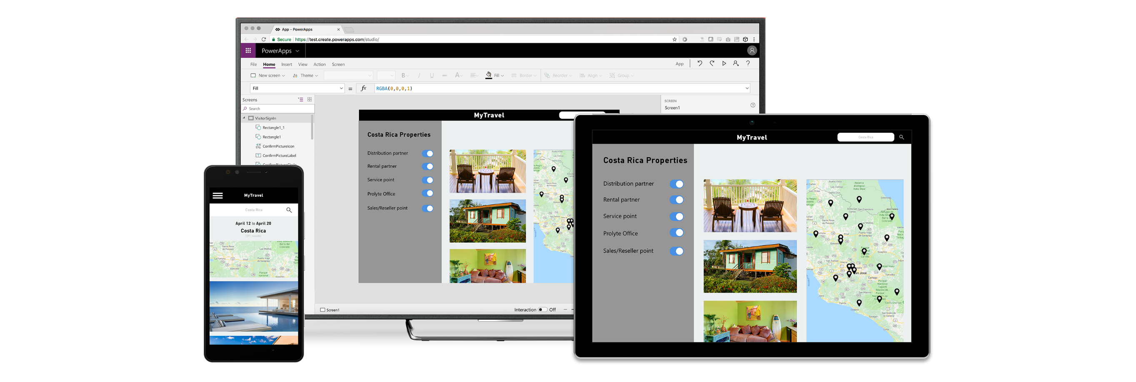
Innovate faster with a low-code/no-code platform
Reduce time & cost building business applications
Drive system-of-record to a single view to simplify your business processes and remove silos in your company
Enrich your apps connecting to your most critical business data and automating
© Microsoft Corporation PowerApps
Notes:
With a low-code, no-code platform, you can reduce the time and cost associated with developing custom business applications, drive systems-of-record to a single view in order to simplify your business processes and remove data silos in your organization and enrich your apps by connecting them to your most critical business data and automate your business processes.
Now, let’s take a look at some real-world customer success stories…

Slide 10
Know Your Customers – Opportunities Creating a high-quality in-store customer welcome experience
Company Size
2,800+ Employees
Industry
Retail Banking
Headquarters
United Kingdom
PowerApps Champion
Bruce Rioch, Chief Data Officer
“The ability to build an app within a few days or weeks is just fantastic. And then to rapidly get it deployed out to our business is something we’ve never seen before.”
- Bruce Rioch, Chief Data Officer, Metro Bank
© Microsoft Corporation PowerApps
Notes:
This first case study is an example of not only knowing your customers, but also empowering employees.
Metro Bank opened its doors in July 2010 as the first new high street bank to open in London in more than 100 years. Since then they’ve grown to over 50 branches (aka "stores") serving over a million accounts.
Metro Bank wanted to differentiate themselves by providing a high quality in-store welcome experience for customers. A key objective was – “if a customer walks in the door, let’s solve their problem today.” This VIP customer service differentiated them from other banks, some of which required appointments to be booked weeks in advance.
They envisioned a scenario where a customer was welcomed by a greeter with an app on a tablet device. The app would help determine with high accuracy the estimated wait time, and pair up the customer with the appropriate representative. The customer could then wait inside the store or leave and be notified via a text message 10 minutes before their appointment.
The historical data created by the app would help train their wait time estimation models, further increasing the accuracy of those estimates, leading to a better store visit experience.

Slide 11
Know Your Customers – Challenges
Greeter wrote down customers names on paper clipboard
Greeter had to go back to desk to look up customer info in CRM
No ability to accurately estimate customer wait time or adapt staffing based on customer traffic patterns
© Microsoft Corporation PowerApps
Notes:
Prior to the PowerApps Platform implementation, the greeter at the bank used a paper clipboard to write down customers names. They had to go back to their desk if they needed to look up customer info in their CRM system. This was not a great customer experience. Moreover, they were unable to accurately predict how quickly a customer could be served as they did not have any data to analyze customer traffic patterns and adapt their staffing accordingly.

Slide 12
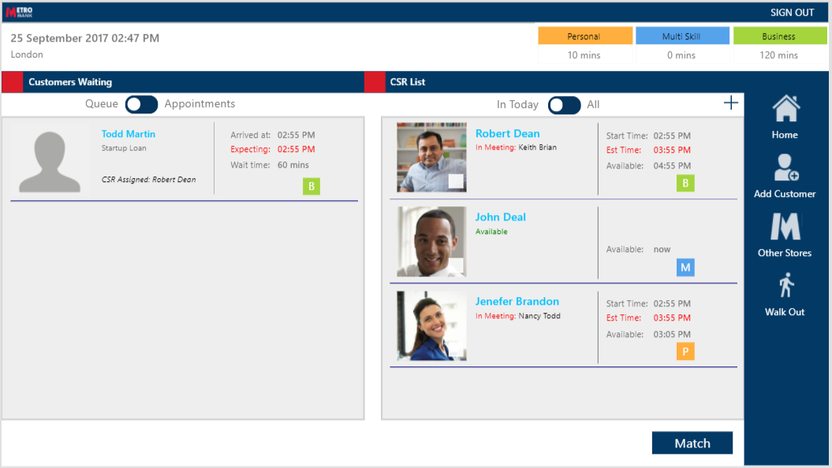
Know Your Customers – Results
Tablet-based greeter experience delivers high-end brand promise
Increase in net promoter scores (NPS)
Detailed real-time traffic information in each store down to a single customer helps identify issues and accurately predict wait times
© Microsoft Corporation PowerApps
Notes:
They developed a PowerApps tablet app that is used by greeters in the bank to welcome customers and ensure the best possible experience. It took four weeks to develop the first version and it was deployed to the first store in two months. The app first went live in April 2017 and has been in production and used daily in all 50+ stores since December 2017.
The app allows the greeter to search for the customer, look up who is waiting, which employees are available, and additional data such as when the next customer service agent will come back from lunch. The app can accurately predict wait times. The customer can choose to wait in the store or leave and be notified via a text message when the teller is available. They can also check wait times in other stores nearby or book an appointment for another day.
Customer service representatives (CSRs) also use the app to indicate their shift times and lunch breaks. Collectively, this creates a lot of valuable data for analysis and insights.
Benefits from using the Power platform include:
Providing a tablet-based greeter experience that delivers the high-end brand promise that Metro Bank sought to establish which, in turn, has resulted in increased net promoter scores (NPS)
Empowering greeters and tellers with the information they need to help the customer through a task-based user interface.
Knowing the traffic in each store, down to a single customer need. If a customer complains, employees can look at the history and know exactly what happened.
Because PowerApps is an extension to Dynamics 365, all the existing GDPR and security processes that were already being handled were instantly applicable to the solution.
Metro Bank can now fulfill the customer promise of providing credible wait times, and if it’s running longer than expected, they can let the customer know.

Slide 13
Empowering Employees – Challenges Rapidly delivering powerful apps at low cost using in-house resources
Company Size
1,600+ Employees
Industry
Consumer Goods
Headquarters
United States
PowerApps Champion
Eric McKinney, Cloud Services Manager
“I could tell immediately that PowerApps would be a game changer for our org. It brought app development down a notch, so our team could leverage it to help improve business processes, gather insights and do it rapidly.”
- Eric McKinney, Cloud Services Manager
© Microsoft Corporation PowerApps
Notes:
Case study available here https://customers.microsoft.com/en-us/story/gj-pepsi-consumer-goods-powerapps
G&J Pepsi, headquartered in Cincinnati, Ohio, has more than 1,600 employees focused on manufacturing, distributing, and marketing the full line of Pepsi-Cola products. Most staff members spend their time in the field managing their retail accounts.
Eric McKinney, Cloud Services Manager, and the G&J IT team, was tasked with delivering more on-the-go services for the company as the industry is becoming more reliant on mobile phones and tablets for business. With a goal of becoming more efficient, gaining new insights, and keeping the company better connected with its customers, he set out to create a better experience. By using Microsoft PowerApps, Power BI, and Microsoft Flow, the seven-person IT team created custom applications to automate the company’s store audit and merchandising process. They were able to build, deploy, and manage this scalable end-to-end solution without previous app development experience.

Slide 14
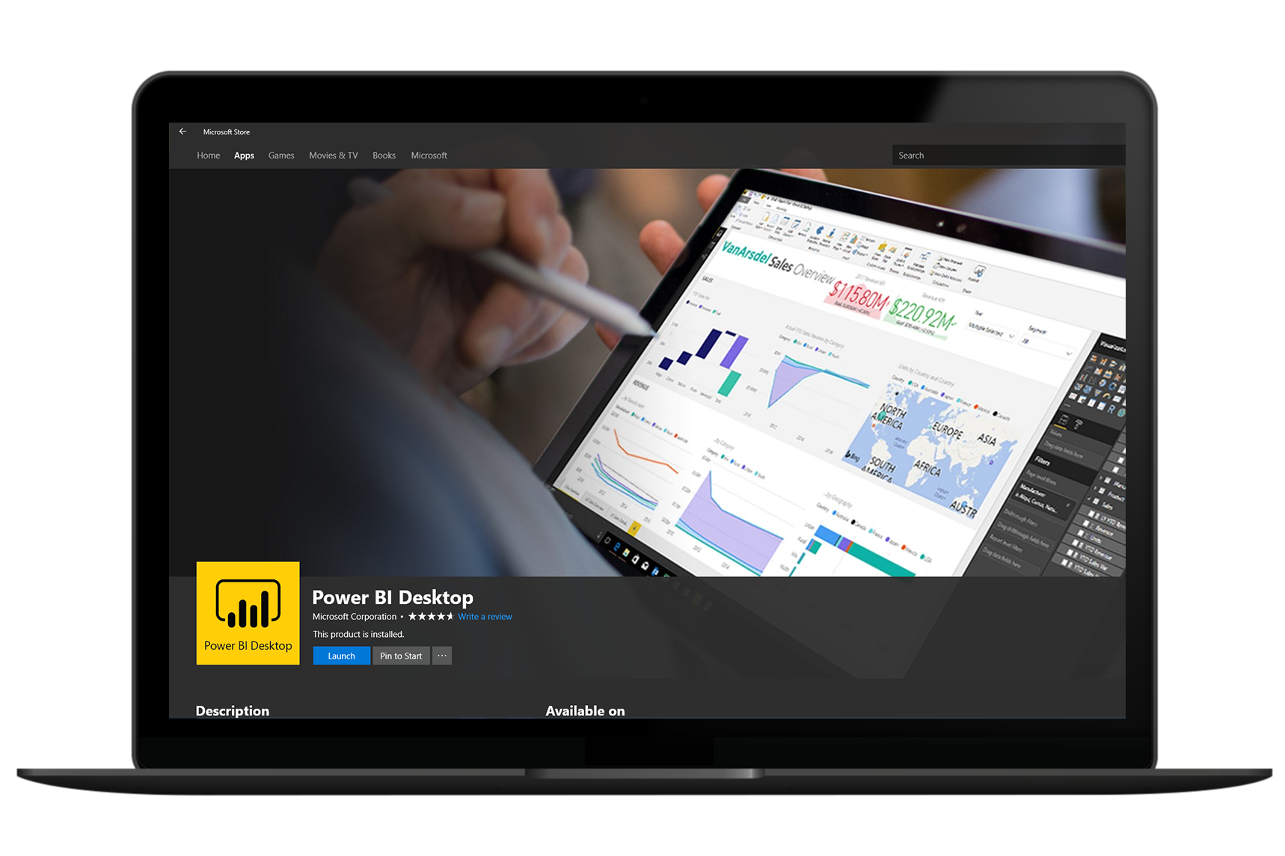
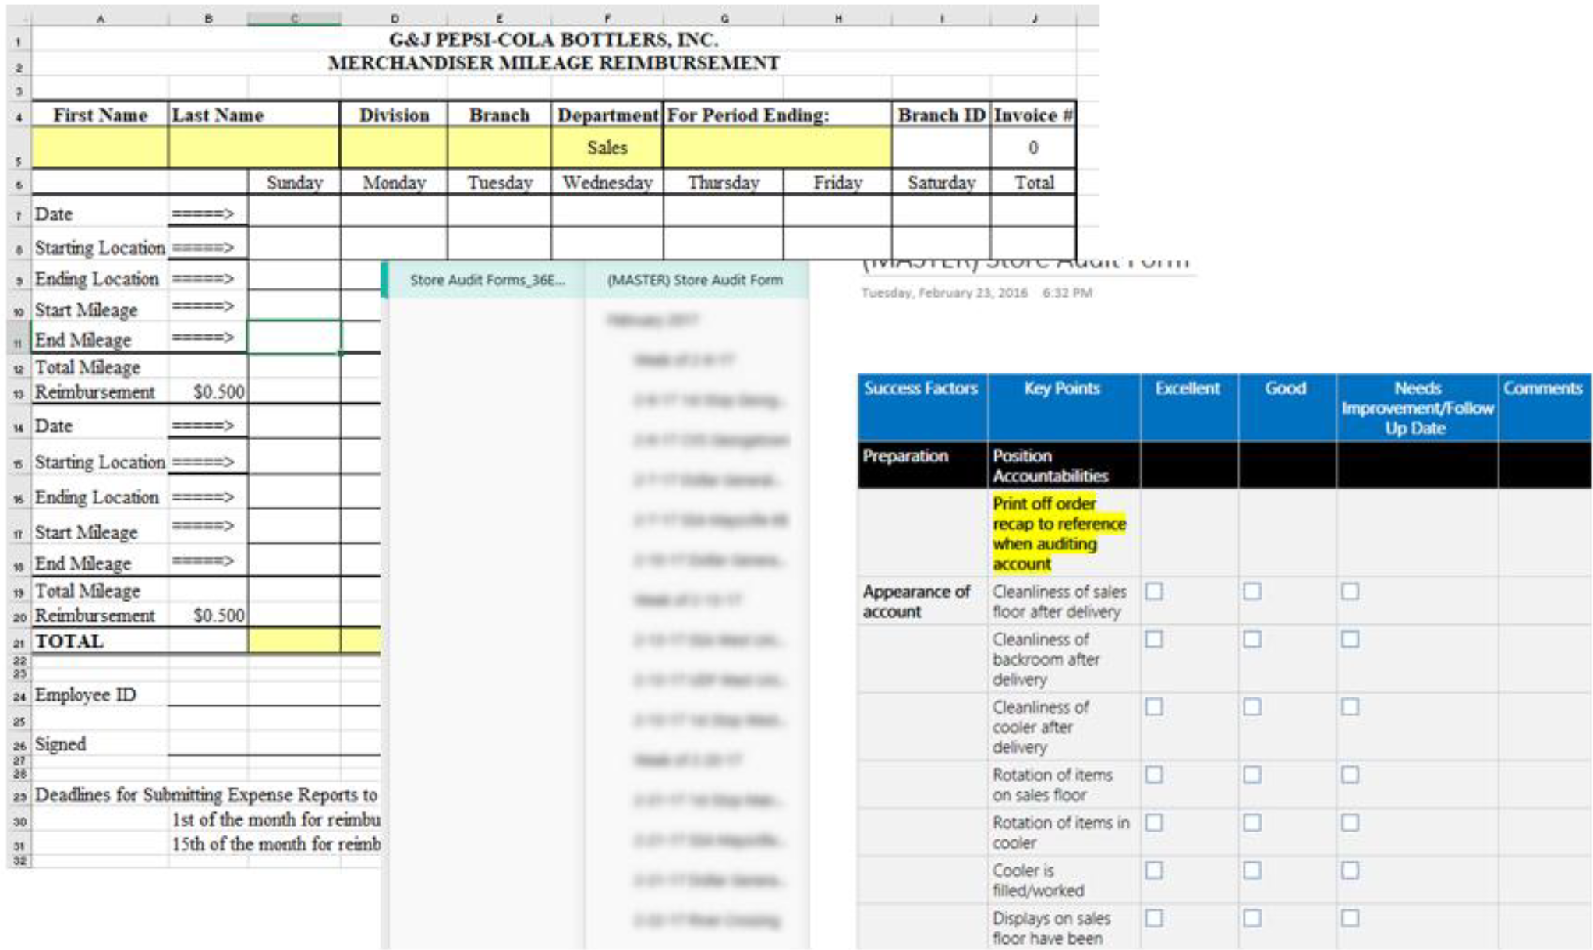
Empowering Employees – Challenges
Store audits recorded on paper with little accountability and often no resolution
Merchandising emails disappeared into a “black hole”
Limited IT staff with no developer experience
Some content blurred for confidentiality
© Microsoft Corporation PowerApps
Notes:
G&J Pepsi’s IT team knows a lot about networking, databases, leveraging applications, and more, but none of them consider themselves to be developers. The team had worked in Microsoft Office 365 for a while and had already successfully integrated Exchange Online, Yammer, OneDrive for Business, and SharePoint Online into the organization. So when Eric learned about Microsoft PowerApps, he thought it could be a great fit for simplifying and mobilizing processes for G&J Pepsi’s field workers.
His team was already comfortable using cloud-based applications, and with PowerApps, they could create custom web and mobile apps without writing any code. Eric hoped to create a rich mobile experience that matched what users were accustomed to on their personal devices.
The G&J Pepsi IT team used PowerApps to create Store Audit, an app that enables better mobility and flexibility for field personnel. Previously, they’d record key information from a store audit on a piece of paper, then place it in a tray with little accountability and often no resolution. Now, those in the field can inspect stores, collect data, provide an aggregated view to leadership, and better ensure customer satisfaction.
Similarly, they created a merchandiser app for better store tracking. If, for example, delivery personnel see displays that need to be fixed, they now know that submitting this information will trigger alerts to the supervisor and upwards. Previously, their only course of action was to email the salesperson, with no assurance the salesperson would be available to respond.
With both apps, information is now captured in real-time. Power BI dashboards visualize the data for quick overviews and deep dives into the numbers, and Microsoft Flow—another cloud-based service—triggers alerts to the relevant teams. Creating in PowerApps helped the team steer clear of hurdles that could occur when developing without professional developers. With cloud systems already in place, they’ve been able to primarily lean on just two team members who can build applications. Even without scaling up staff, the apps were up and running in a matter of weeks.

Slide 15
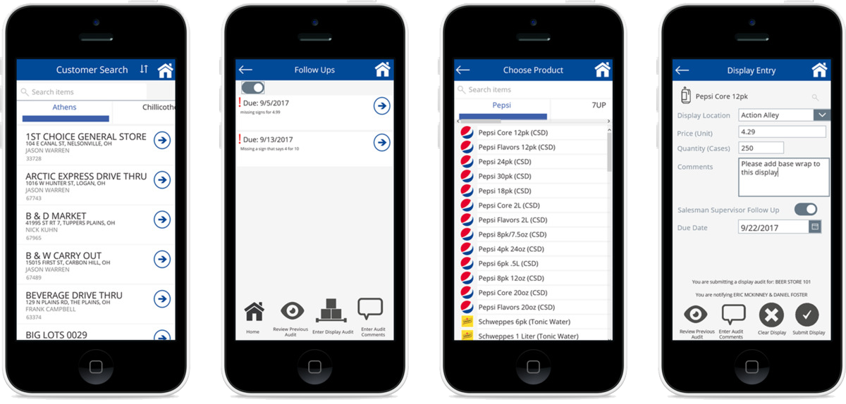
Empowering Employees – Results
15,000+ surveys submitted via store audit module
$500,000 in first-year savings by avoiding outsourced vendor app
New insights and mobile services delivered to 900+ field personnel
© Microsoft Corporation PowerApps
Notes:
By learning while creating their key line-of-business apps, the G&J Pepsi IT team has already built eight applications ranging from time trackers and driver notifications to sales operations requests. They continue to evolve the applications and identify new application opportunities to address challenges that IT teams without application development capabilities face.
G&J Pepsi field reps have already submitted more than 15,000 surveys via the store audit module. The enthusiasm about this new way of collecting and aggregating information, and ultimately creating meaningful and actionable insights, has started what Eric calls an “app revolution.” Improved communication and the ease of accessing data have empowered the field team and sales personnel to accomplish more.
The apps saved G&J Pepsi about $500,000 in just the first year. Much of the savings come from Eric’s team being able to avoid outsourcing another vendor’s merchandising app, at a cost of $240,000 for the first year. And most importantly, this simplified—and more efficient—customer experience is already impacting customers via better communication and faster turnarounds on requests.

Slide 16
Intelligent Supply Chain – Opportunities Driving better inventory buying decisions with PowerApps
Company Size
4,800 Employees
Industry
Automobile Retail
Headquarters
United States
PowerApps Champion
Jonathan Oberhaus, PowerApps Developer
“We used PowerApps to build an app that turns experience and intuition into a consistent, accurate, and repeatable business process.”
- Lisa Aguilera, Assistant Director, Business Intelligence
© Microsoft Corporation PowerApps
Notes:
Case study available here https://customers.microsoft.com/en-us/story/drivetime-retail-consumer-goods-azure
When DriveTime wanted to streamline and automate manual, intuition-based vehicle purchasing, the company used Microsoft PowerApps and Azure SQL Database to make the process more cost-effective. With the Online Buyer web app built on PowerApps, DriveTime inspectors and buyers can remove guesswork, save time, and transform hard-earned business knowledge into an accurate and repeatable purchase process.
Between online sales and more than 140 dealerships across the United States, DriveTime sells a lot of used cars, more than $2 billion worth a year. But before it can sell them, DriveTime has to buy all those cars. In 2016, the company purchased 160,000 vehicles.

Slide 17
Intelligent Supply Chain – Challenges
Buyers rely on experience knowledge and “gut” instinct
Buying process recorded on paper
No real-time backoffice visibility into buying decisions
© Microsoft Corporation PowerApps
Notes:
To buy any used car, it takes some work to find the best value, and DriveTime is committed to delivering value for its customers. So historically, the company sent its 65 buyers to physically inspect and purchase tens of thousands of vehicles at public car auctions all across the country. The buyers relied on their years of experience, knowledge, and gut instinct, and they recorded the whole process—on paper.
DriveTime wanted a more efficient, systematic way to purchase vehicles at auctions, so it used Microsoft PowerApps and Azure SQL Database to build a business app that would help the company streamline, automate, and reinvent its auction processes.
Public auto auctions are big, and they move quickly. DriveTime buyers had to work fast, connect with the office for critical information, and make decisions on the fly. The office had almost no real-time visibility into the auction, and afterward, the buyers threw away their notes.
DriveTime wanted to create a customized app, but the Business Intelligence team could not get IT priority or budget for .NET development. So the team used PowerApps to build and deploy its own low-code web app called DriveTime Online Buyer.

Slide 18
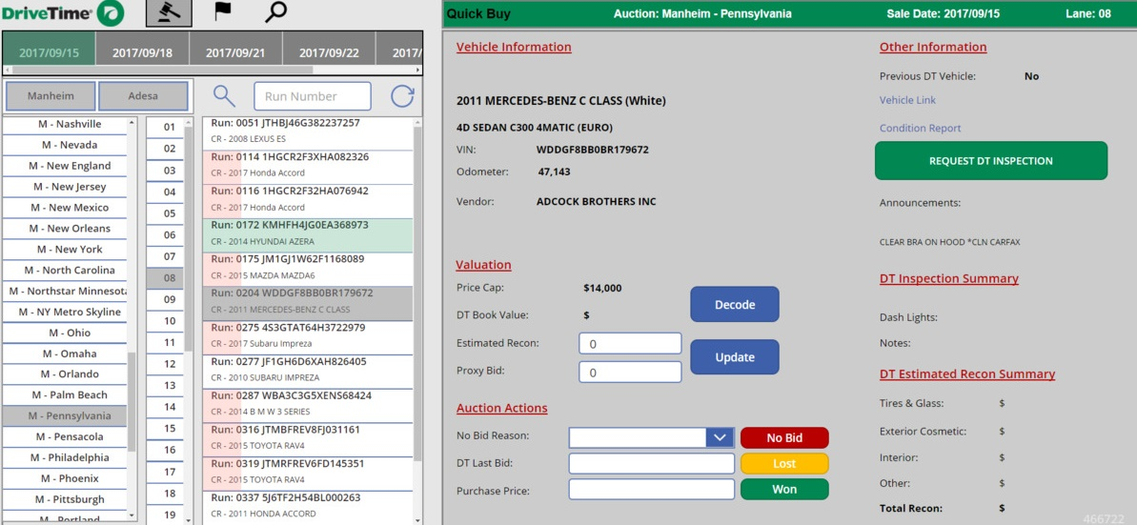
Intelligent Supply Chain – Results
Travel to online auctions drastically reduced and 3x productivity increase
Real-time communication and collaboration between buyers and inspectors
Potential savings of $1.6 million annually
© Microsoft Corporation PowerApps
Notes:
With Online Buyer, instead of traveling to a single auction and walking lanes of cars, DriveTime buyers connect from their desktop to a video feed and view every vehicle in up to four auctions at once.
After an iterative design process, DriveTime used PowerApps to develop the Online Buyer front end and data structure in about a week. Once Online Buyer was launched, DriveTime buyers reported simple, fast performance and a smoother auction workflow.
DriveTime inspectors at the auctions use a mobile inspection app to send itemized reports to Online Buyer for selected vehicles. Buyers can also send real-time inspection requests directly to the mobile app. Online Buyer gathers data from the inspection app, auction presale FTP feeds, and a Kelly Blue Book API. The app uses a DriveTime algorithm to identify and select brand-worthy vehicles for inspection, and it uses Microsoft Flow to automate workflows and help move data between Azure SQL Database and the DriveTime on-premises data structure.
The buyers use the inspection reports and web services in Online Buyer to estimate recondition costs, decode Kelly Blue Book values, make purchase decisions, and then calculate and track bids.
By replacing a completely manual process with Online Buyer, DriveTime has made it easier for buyers and inspectors to communicate, collaborate, and build a knowledge repository.
DriveTime is using its knowledge repository to make better judgements—and to build a database for strategic analysis. Now the company can capture auction, purchase, and reconditioning data, and use it to win more bids at the best price, reduce reconditioning costs, and ultimately provide customers with the highest-value vehicles.
DriveTime business groups, from strategic analytics to call centers, will use Online Buyer as a model to get around IT backlogs, build new applications, test new processes, and solve business problems.

Slide 19
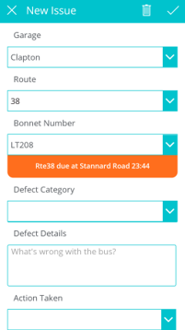
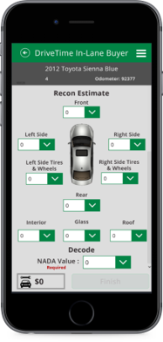
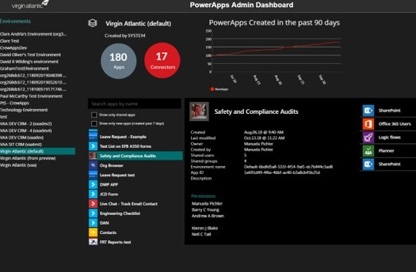
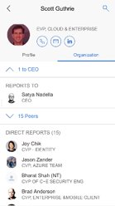
Introducing PowerApps
Rapidly build apps with point-and-click ease to automate business workflows and processes
web.powerapps.com
© Microsoft Corporation PowerApps
Notes:
With Microsoft PowerApps, workers are empowered to quickly build powerful apps to solve everyday challenges themselves – with absolutely no coding knowledge or development experience needed.
PowerApps is a low-code/no-code platform with a canvas-based point-and-click design approach that allows your business users to quickly connect to your data and automate your business workflows and processes with the ease of creating a PowerPoint presentation.
Best of all, you can get started with PowerApps today because it’s included in your Office 365 subscription.

Slide 20
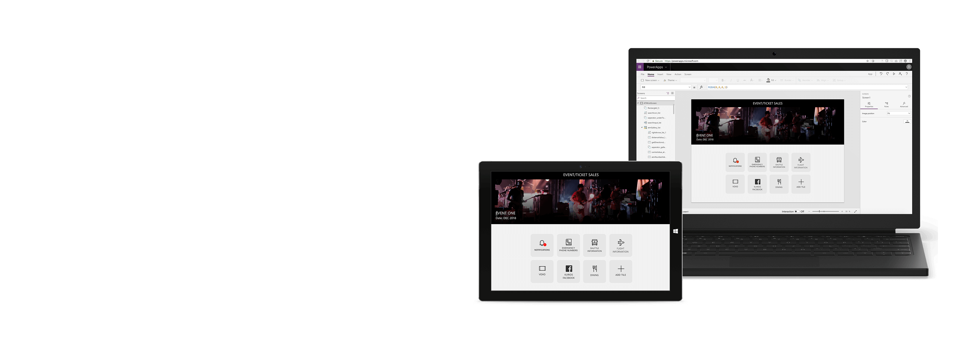
A unique approach to building business apps
Easily build apps with a full-featured low-code/no-code platform
Connect to all your data with pre-built connectors, custom connectors
Put your data to work with the Common Data Service for Apps
Office 365, Azure, Dynamics 365, Power BI, Microsoft Flow Integration
Strong enterprise governance & security
Pro-dev extensibility
© Microsoft Corporation PowerApps
Notes:
Easily build apps
Rich canvas-based authoring. Full creative freedom to place controls and craft user experiences with a PowerPoint-like canvas “True WYSIWYG”: use the app while building it. Creators work with live data and can directly use the app as they work, getting instant feedback that helps build great user experiences faster and more intuitively for business developers.
Template apps for phone, tablet, and web. Get started quickly with pre-built apps covering common business development scenarios across devices and form factors, ranging from customer service to site inspections. PowerApps automatically connects to data source and imports the schema. The end result is a fully functional app connected to the user’s data.
Connect to any data
Connect your data with Common Data Service for Apps
Built-in connectors to more than 200 systems and services
Create custom entities to extend
Access data stored on-premises with the data gateway
Enterprise governance & security
Unified admin center provides comprehensive management across 1st party, 3rd party and custom apps in an AAD tenant or environment, including DLP, backup, and audit logs
Compliance with 13+ standards including HIPAA, EU Model Clauses, SOC and GDPR
Mobile Application Management/Model Device Management via Intune
Pro-dev extensibility
Visual Studio plugin, robust Azure integrations, and in-line serverless code amplify pro developer productivity at every step.
Robust APIs and SDK support. Hook into business processes and actions and pre- and post-processing and interface with client events.
Custom controls and connectors. Pro devs provide building blocks by bringing their any REST interface or custom UI control
Integration with Office 365, Azure, Dynamics 365, Power BI, Microsoft Flow
Tight integrations with SharePoint, Excel, Infopath, Access, Microsoft Teams that enables embedding PowerApps in the context of your productivity apps
Integration with Microsoft Flow for simple integration SaaS (iSaaS) integrations
Connection to Azure Functions for more complex external business logic and event based
Integration with Power BI that enables to embed Power BI dashboards in PowerApps and PowerApps apps in Power BI enabling insight to action scenarios

Slide 21
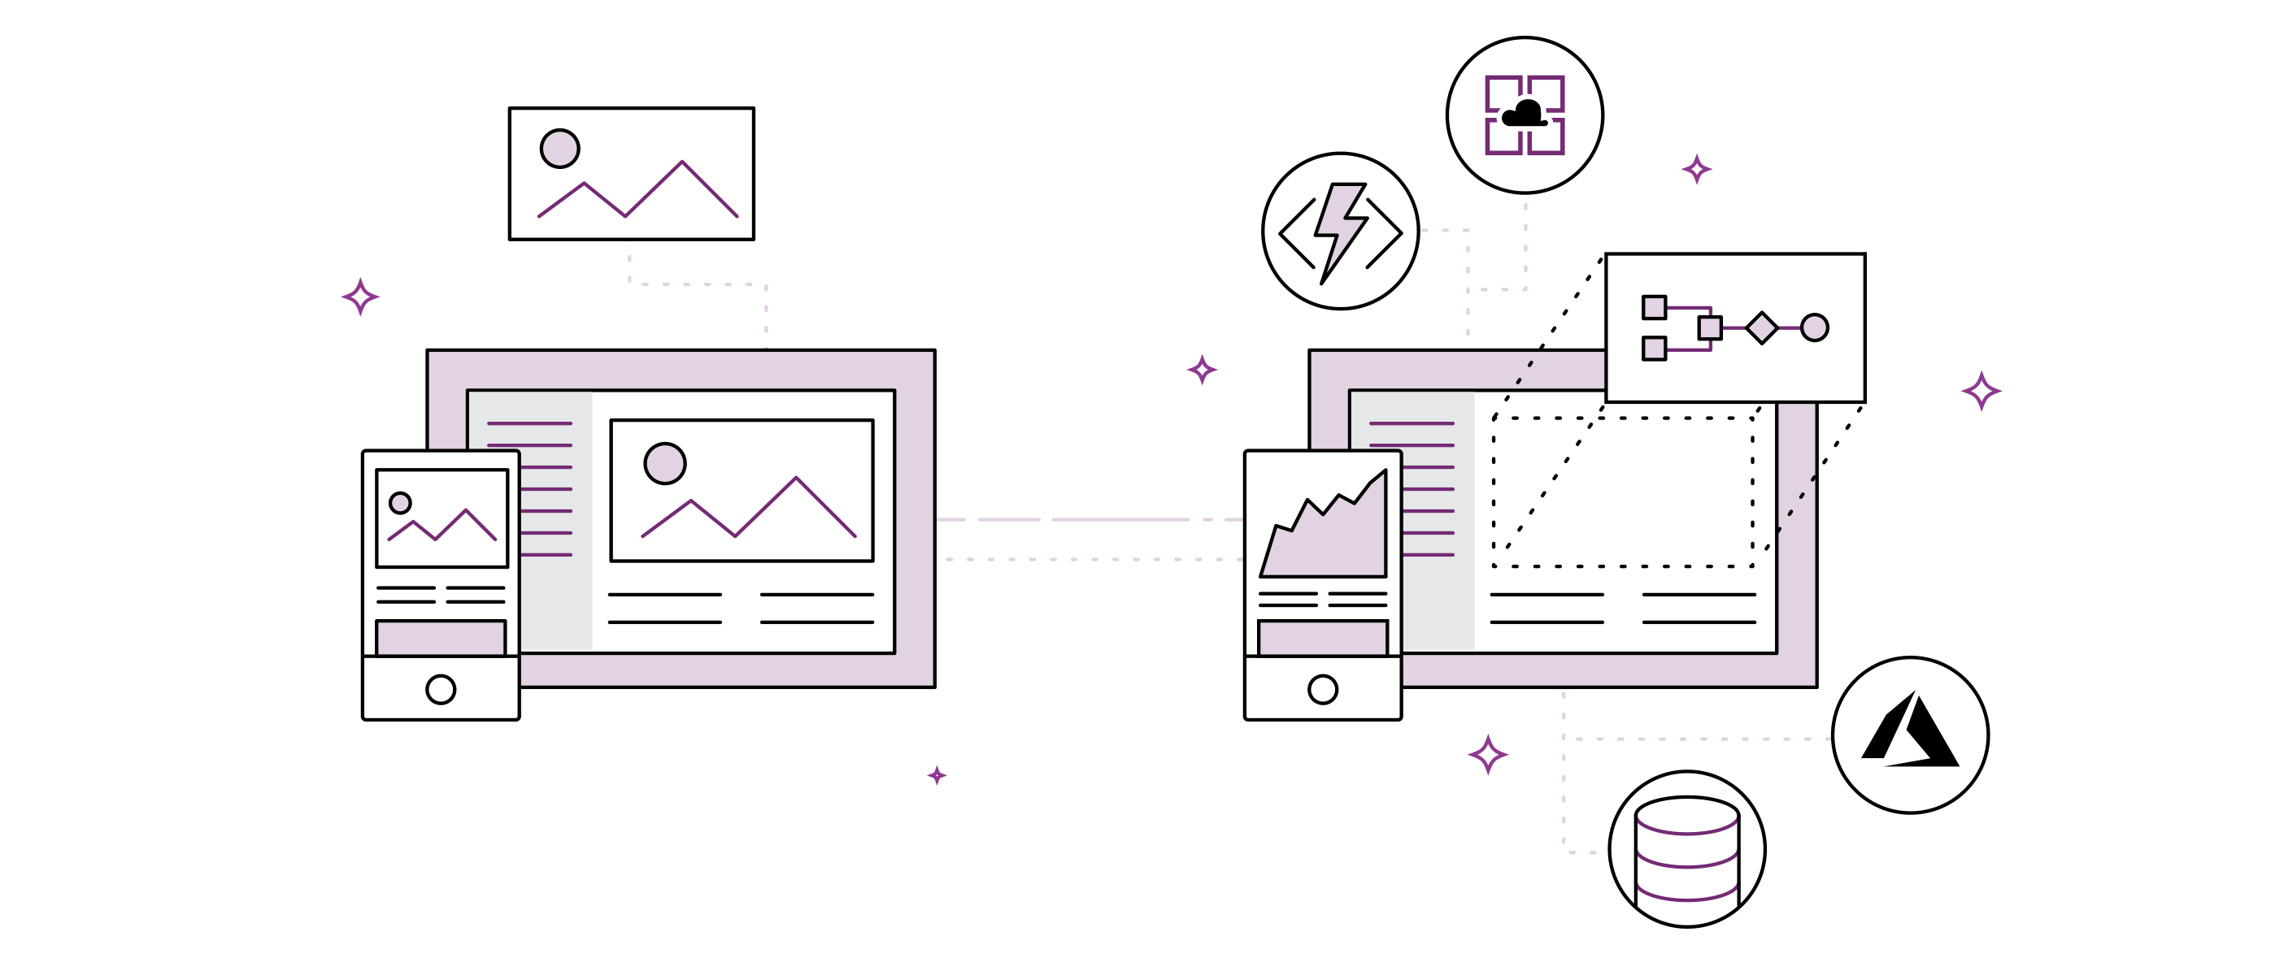
PowerApps Demo
© Microsoft Corporation PowerApps

Slide 22
Know Your Customers – Opportunities Creating a high-quality in-store customer welcome experience
Demo Available in Live Drive
“The ability to build an app within a few days or weeks is just fantastic. And then to rapidly get it deployed out to our business is something we’ve never seen before.”
- Bruce Rioch, Chief Data Officer, Metro Bank
© Microsoft Corporation PowerApps

Slide 23
Empowering Employees – Challenges Rapidly delivering powerful apps at low cost using in-house resources
Demo Available in Live Drive
“I could tell immediately that PowerApps would be a game changer for our org. It brought app development down a notch, so our team could leverage it to help improve business processes, gather insights and do it rapidly.”
- Eric McKinney, Cloud Services Manager
© Microsoft Corporation PowerApps

Slide 24
Total Economic Impact (TEI)
We used to have three full-time people writing reports. That’s now down to only one person
—CLIENT
In the first year we saved $500,000 in external developer costs. We expect to see similar savings in future years
—CLIENT
We reduced our time to quote from twelve days down to four
—CLIENT
70%
Less app dev cost and effort
362%
ROI over 3-year term
<3 Months
Payback
Source: The Total Economic Impact™ Of PowerApps And Microsoft Flow, a commissioned study conducted by Forrester Consulting on behalf of Microsoft, June 2018
Source: The Total Economic Impact™ Of PowerApps And Microsoft Flow, a commissioned study conducted by Forrester Consulting on behalf of Microsoft, June 2018
© Microsoft Corporation PowerApps
Notes:
To better understand the benefits, costs, and risks associated with this investment, Forrester interviewed four customers using PowerApps and/or Flow. Interviewees said that by reducing application development time and empowering non-developers to create custom applications and workflows they were able to greatly reduce development costs and streamline business processes. These process improvements delivered business benefits such as reduced time-to-market, better customer service, and increased revenues.

Slide 25
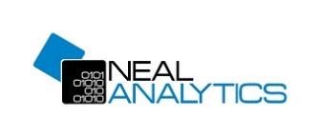
230+
Partners covering 70+ countries delivering solutions and consulting offerings
© Microsoft Corporation PowerApps
Notes:
Slide Objective:

Slide 26
Getting started with PowerApps
PowerApps plans for all your needs
PowerApps for Office 365
PowerApps Plan 1
PowerApps Plan 2
Customize and extend Office 365
PowerApps for Office 365 is included as part of your Office 365 subscription so you can start customizing and extending your Office 365 experience
Bridge digital gaps
If you want to connect to data in your technology stack (on-premises or cloud), to third-party cloud services, or to the Common Data Service for applications
Advanced management & control
If you want to digitize more complex business processes and workflows with increased governance and administration of your apps and full access to the Common Data Service for applications
© Microsoft Corporation PowerApps
Notes:
PowerApps is designed to be a no cliffs application development platform that supports a wide range of apps and use cases, from power users customizing and extending their Office 365 experience and data to developers creating apps that map complex business processes and work with large volumes of data in the Common Data Service for Applications.
The PowerApps portfolio of offerings supports this vision with plans that cover all the business needs of an organization:
• PowerApps for Office 365 extends Office 365 productivity scenarios with apps that connect to Office 365, other Microsoft cloud services, and standard data sources—these additional apps operate in the context of Microsoft 365.
• PowerApps Plan 1 enables users to create and run more advanced business apps that can connect to all your enterprise data (whether from custom applications, additional 3rd party cloud services, or on-premises) and take advantage of the Common Data Service for Apps to manage and operate business data and add more sophisticated logic to the apps. Plan 1 enables organizations to create rich business apps that operate beyond Microsoft Office 365 and Microsoft clouds.
• Power Apps Plan 2 allows organizations to develop apps that address scenarios with more complex business rules, workflows and code plug-ins. Plan 2 apps also provides access to more capabilities and capacity from the Common Data Service for Applications, including the ability to read and write restricted entities.

Slide 27
Microsoft Power platform
PowerApps
Power BI
Microsoft Flow
Dynamics 365
Common Data Service for Apps
Data Connectors
Azure
Office 365
Standalone Apps
© Microsoft Corporation PowerApps

Slide 28
It’s easy to get started…
Learning resources at aka.ms/powerapps-resources
If you are an Office 365 customer, try PowerApps with Office 365
Start a free trial
© Microsoft Corporation PowerApps

